Slide 1
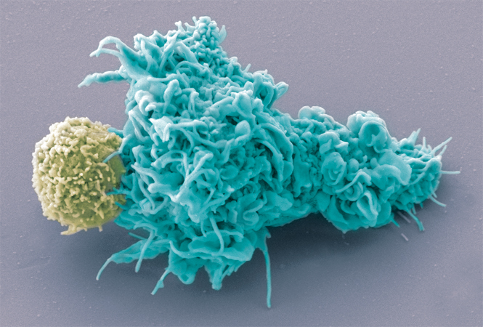
The Immune System
Cell Press
Immune synapse between a T cell and a Dendritic cell
Image: Olivier Schwartz and Electron Microscopy Core Facility, Institut Pasteur

Slide 2


I. Introduction to the Immune System
by Bruno Lemaitre,
Ecole Polytechnique Fédérale de Lausanne
Web: http://ghi.epfl.ch
Support:
Animations and illustrations by HSET ©. Nathalie Debbard, Jean-Pierre Kraehenbuhl
Editing: Claudine Neyen

Slide 3
Introduction to Immunology
Objectives of the immunology module:
Understand the structure and function of the immune system (from molecules to tissues to organisms)
Gain insight into the innate and adaptive defences against microbes
Discover some applied aspects of immunology: transplantation, vaccination, allergy, auto-immune diseases
Recommended reading:
Immunology, by Eric Espinosa and Pascal Chillet, published by Ellipses
Basic Immunology, by Abul K. Abbas and Andrew Lichtman, published by Elsevier-Masson

Slide 4
Host-pathogen interactions are diverse
Symbiosis
Commensalism
Mutualism
Pathogenesis
Different types of pathogens:
Co-evolved (ex. Tuberculosis, HIV, Helminths) or opportunistic (ex. Aspergillus, Pseudomonas)
Host-specific, multi-niche, free-living
Long-term or short-term interactions with their hosts
Microbiota: an "ecological community of commensal, symbiotic and pathogenic microorganisms” associated with a Metazoan.

Slide 5
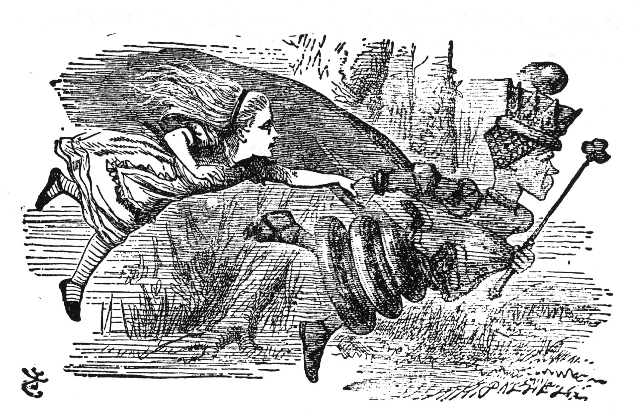
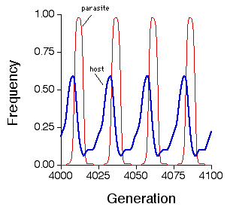
Host-pathogen interactions are dynamic
The Red Queen hypothesis
The immune system is costly in terms of resource allocation. There is a trade-off between immunity and other physiological functions.

Slide 6



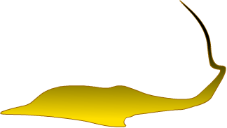

Classes of disease-causing agents
Bacteria | Viruses | Protozoans | Worms | Fungi
Salmonella | HIV (AIDS) | Plasmodium (Malaria) | Schistosoma (dermatitis, hepato-, splenomegaly) | Dermatophytes (cutaneous mycosis)
Shigella (dysentery) | Influenza (Flu) | Leishmania (cutaneous lesions) | Tenia (asymptomatic) | Saprophytes (subcutaneous mycosis)
Staphylococcus aureus | HAV, HBV (Hepatitis) | Trypanosoma (sleeping sickness, Chagas disease)
Pneumococcus (otitis, pneumonia) | Rotavirus (diarrhea) | Toxoplasma gondii (fetal abnormalities)
 |  | Entamoeba histolytica (dysentery)
 |  | Cryptosporidium parvum (diarrhea)

Slide 7
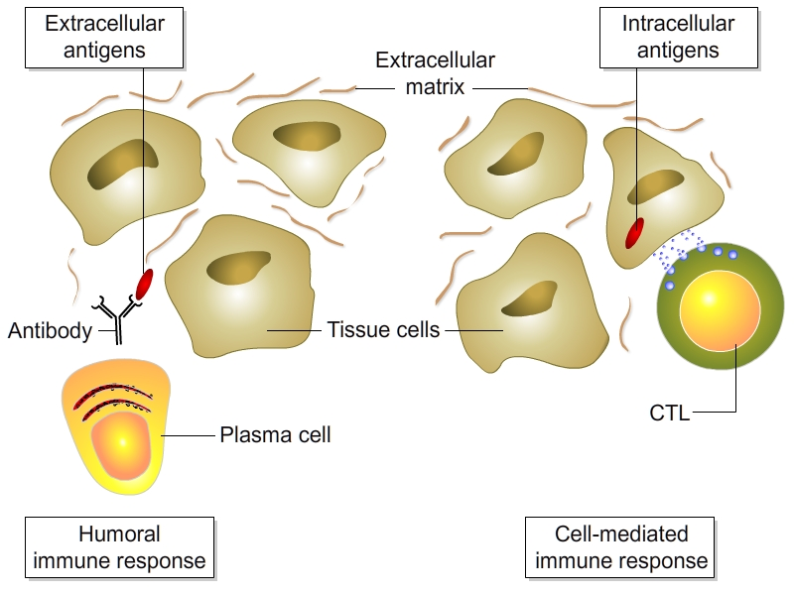
Different pathogen lifestyles require different immune responses

Slide 8

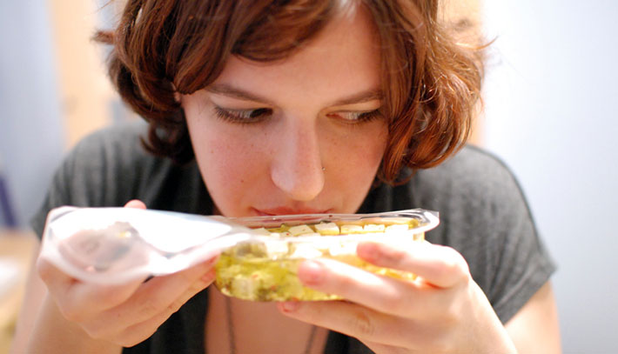
Three ways to resist microbial infection
Avoidance (behavioural): to avoid interaction with microbes
Resilience (or disease tolerance): to better endure the consequences of the infection (e.g. repair, detoxification)
Immunity: to recognize and eliminate invading microbes

Slide 9
Introduction to the Immune System
Immunity is defined as resistance to disease, specifically infectious disease. The collection of cells, tissues, and molecules that mediate resistance to infections is called the immune system.
Immune function | Consequences
Defence against infections | Immunocompromised individuals are at higher risk of infections (e.g. AIDS) Vaccination creates protective immunity
Recognition of foreign tissues (grafts) and proteins | Interferes with transplantation and gene therapy
Defence against tumours | Immunotherapy against cancer
Tolerance of (intestinal) microbiota | Microbiota confinement rupture causes chronic inflammation

Slide 10
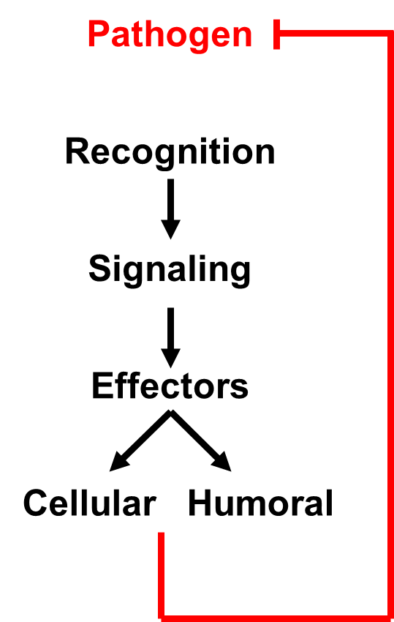
Introduction to the Immune System
An immune system requires
  efficient recognition mechanisms
  (infectious non-self)
  targeted effector mechanisms
Immune disorders include
  immune deficiencies
  auto-immune diseases/allergies

Slide 11
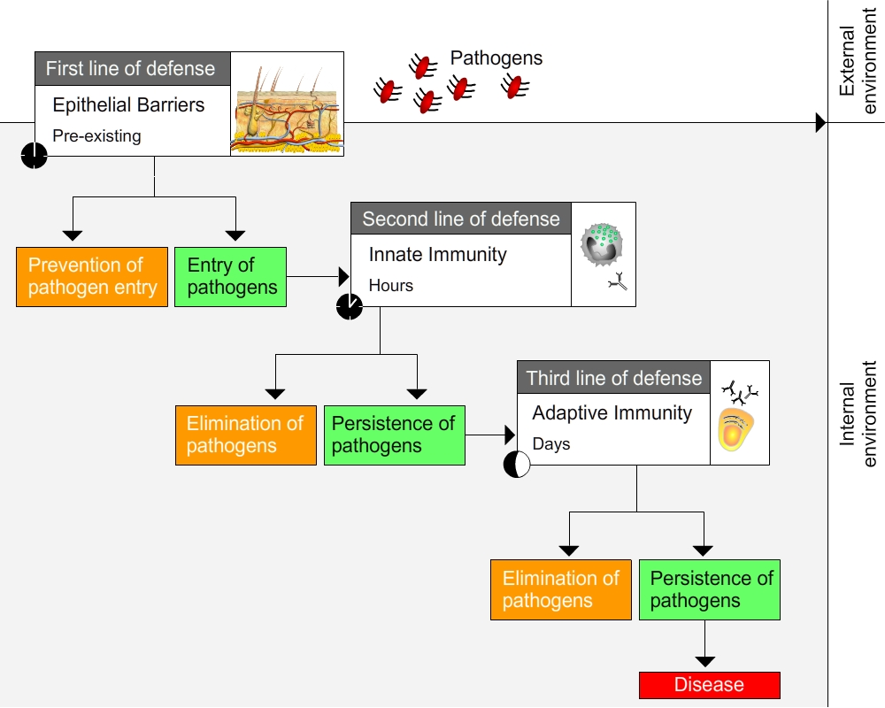
Three lines of defence against infection
Epithelial barriers
Innate Immunity
Adaptive Immunity
Invertebrates and vertebrates are continuously exposed to microbes
Epithelial barriers and innate immunity are common to invertebrates and vertebrates
B and T cell adaptive immunity is specific to vertebrates

Slide 12
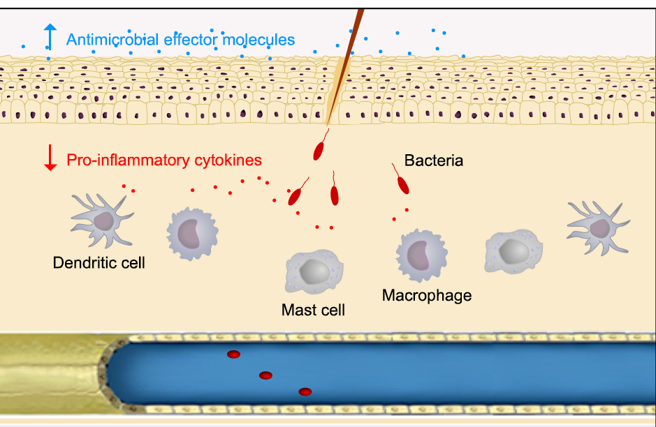
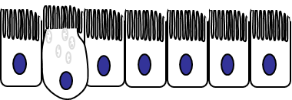
Innate Immunity
The innate immune system consists of:
a wide variety of cells
  circulating in the blood
  and scattered in organs
  forming tissues that separate the outside from the inside world
molecules produced by innate immune cells or the liver
  antimicrobial peptides
  acute phase proteins
  complement
  cytokines & chemokines
Macrophages
Mast cells
Neutrophils

Slide 13
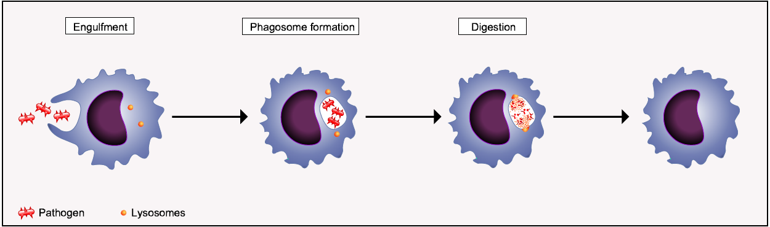
Phagocytosis: a universal mechanism of defence
Phagocytic cells include neutrophils, macrophages, and dendritic cells.
Vacuole
Microbes
Lysosome containing enzymes

Slide 14
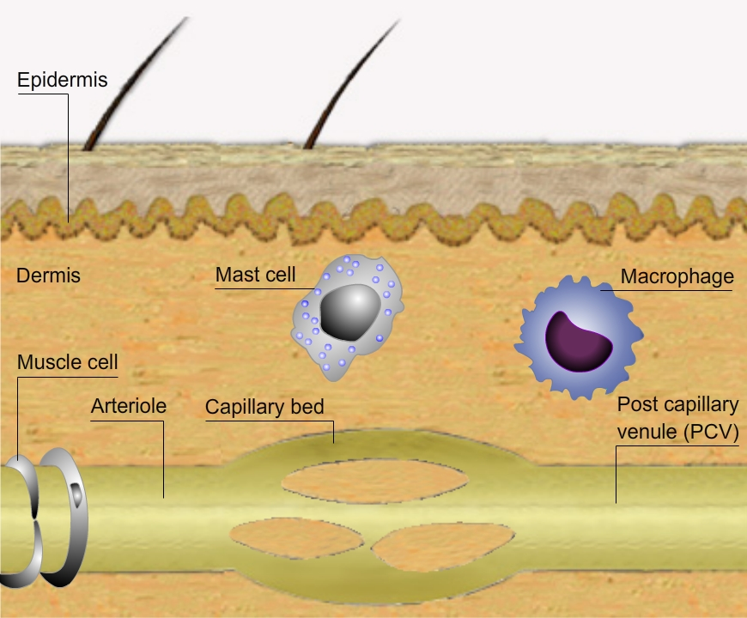
The inflammatory response
After tissue injury, mast cells degranulate. The histamines they release affect local blood vessels: blood flow increases and more macrophages and antimicrobial proteins exit the vessel towards the wounded tissue.
These changes are called the inflammatory response.
Chemokines are chemoattractants.
Cytokines are secreted molecules signaling between different elements of the immune system.

Slide 15
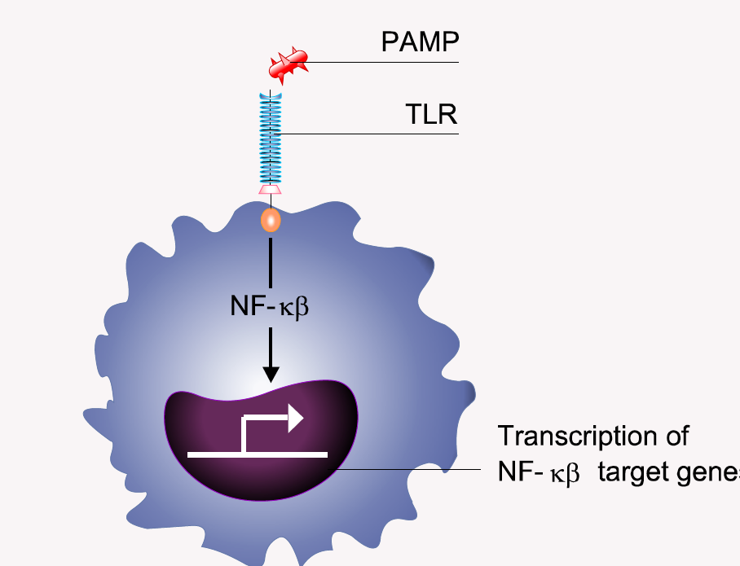
Innate immunity is triggered by receptors that detect molecular structures unique to microbes or molecules that signal damage
(e.g. lipopolysaccharide, LPS)
(e.g. TLR4)

Slide 16
Conclusion 1A
The physiological function of the immune system is to protect individuals against infections.
Innate immunity is the earliest line of defence, mediated by cells and molecules that are always present and ready to eliminate infectious microbes.
Innate immunity consists of barrier tissues (epithelia) and a wide variety of molecules produced by innate immune cells or the liver.
Innate immune mechanisms are diverse: phagocytosis, degranulation, interferons, complement, antimicrobial peptides
Inflammation is a rapid reaction that recruits blood cells and immune molecules to the site of infection

Slide 17
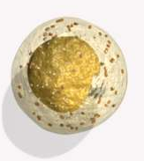

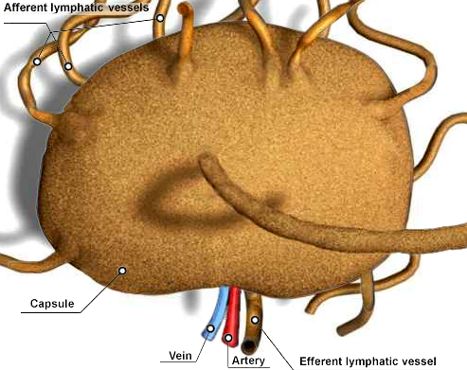
Third line of defence: adaptive immunity
A host defence unique to vertebrates
Mobilizes defences that are adapted to each specific disease-causing agent
Retains a “memory” of previous encounters
The adaptive immune system consists of:
Cells called lymphocytes
Molecules produced by lymphocytes, including antibodies
Organs called lymphoid organs where lymphocytes divide and reproduce, mature, and perform some of their functions. Lymphocytes migrate in and out of lymphoid organs.

Slide 18
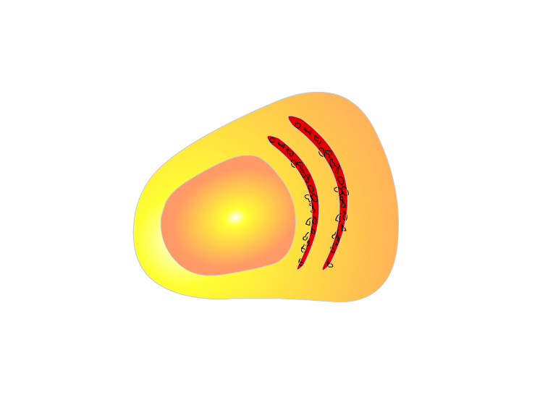
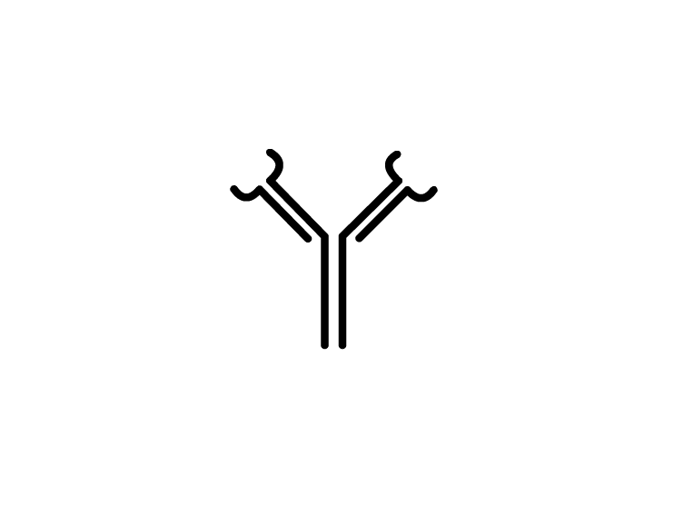

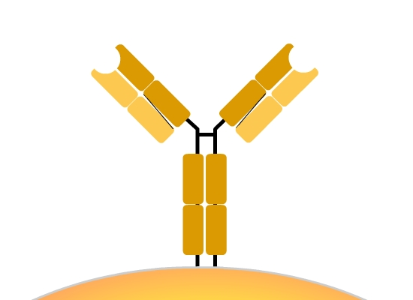
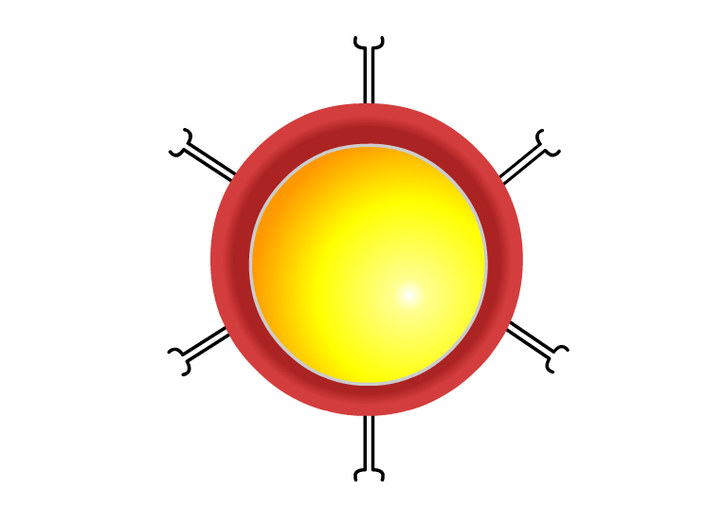
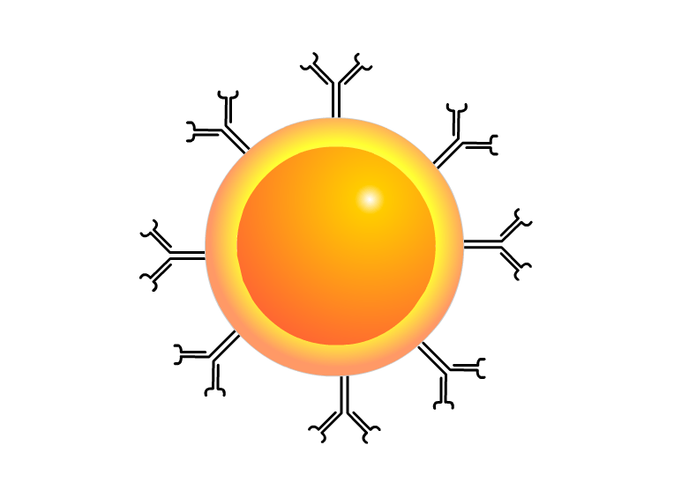
Antigen receptors on B and T lymphocytes
Antigen-
binding site
Antigen-
binding site
Antigen-
binding site
V
V
C
C
V
V
C
B cell
B cell receptor
T cell receptor
T cell
The human body contains an extensive repertoire of B and T cells with specific antigen binding specificity.

Slide 19
Generation of the B and T cell repertoires
What are the mechanisms that define receptor specificity?
What are the mechanisms that prevent activation of an immune response against self-antigens?

Slide 20
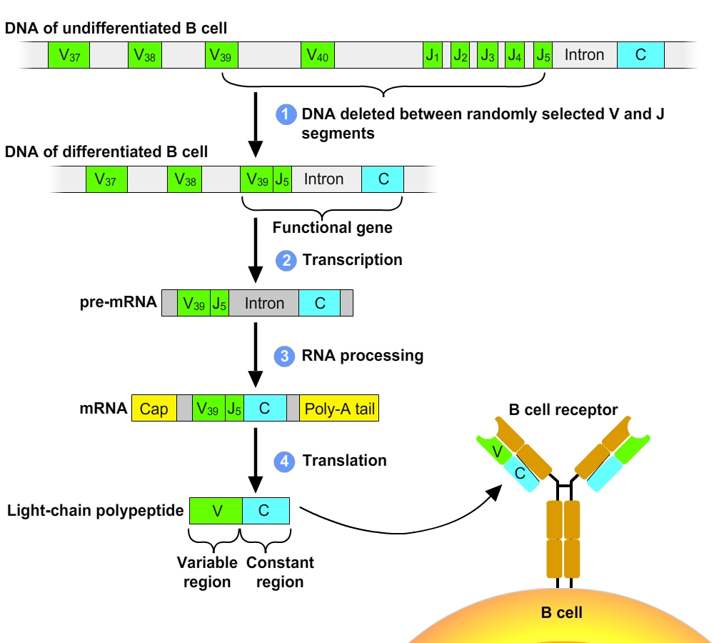
Immunoglobulin gene rearrangement

Slide 21
Summary: Generation of Lymphocyte Diversity by Gene Rearrangement
Differences in the variable region account for specificity of antigen receptors.
The immunoglobulin (Ig) gene encodes one chain of the B cell receptor.
Many different chains can be produced from the same Ig chain gene by DNA rearrangement.
Rearranged DNA is transcribed and translated to form the antigen receptor.

Slide 22
Origin of Self-Tolerance
Antigen receptors are generated by random rearrangement of DNA.
As lymphocytes mature in the bone marrow or the thymus, they are tested for self-reactivity.
Lymphocytes with receptors specific for the body’s own molecules are destroyed by apoptosis, or rendered nonfunctional.
Abbas, Basic Immunology

Slide 23
Two types of adaptive immunity: humoral and cellular
Humoral immunity is mediated by antibodies, which are produced by B lymphocytes.
Cell-mediated immunity is mediated by T lymphocytes:
2 classes of T cells:
  CD4 or helper T cells (T_{H})
  CD8 or Cytotoxic T Cells (CTL)

Slide 24
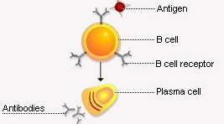
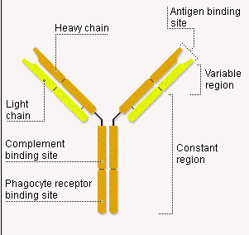
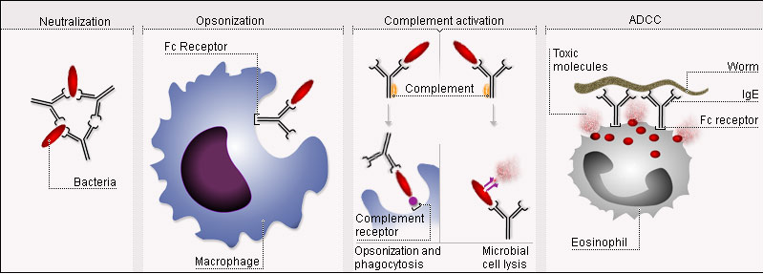
Humoral immunity: Antibodies
Antibodies are produced by B lymphocytes
2 forms: - membrane bound: receptor
- secreted: antibody
Structure
Function

Slide 25
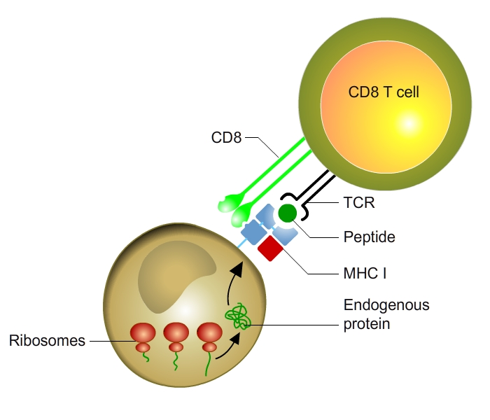
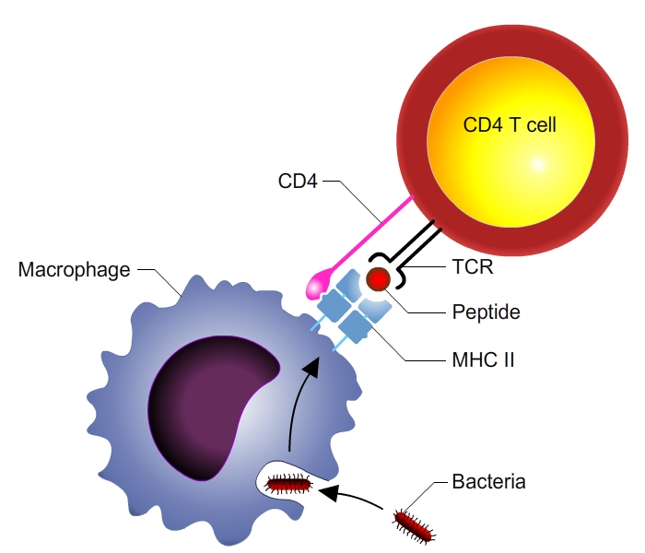
Cellular response: CD4 and CD8 T cells
CD4 T cells activate phagocytes to destroy ingested microbes.
CD8 T cells kill host cells harboring infectious microbes.
Antigens are presented on Major Histocompatibility Complex (MHC) molecules.
MHC genes are highly polymorphic and were initially discovered for their implication in graft rejection
2 types:
  MHC class I: on all cells
  MHC class II: on Antigen Presenting Cells (APCs) (Dendritic cells, B cells, Macrophages)
MHC class I (intracellular antigens)
MHC class II ( mostly extracellular antigens)

Slide 26
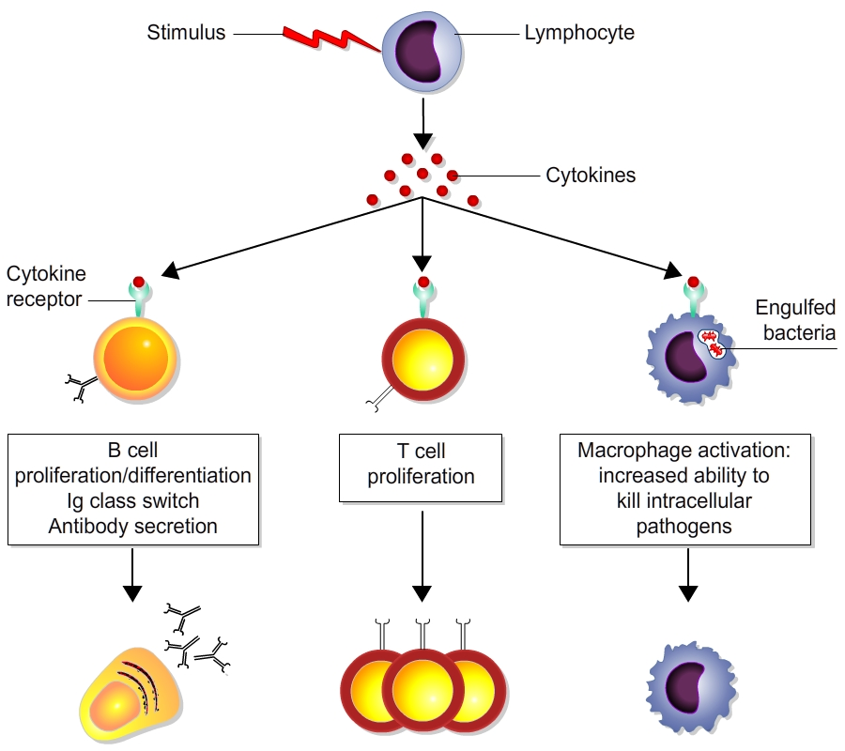
Cytokines: mediators of adaptive immunity
Cytokines are produced by B and T lymphocytes and other immune cells. They include:
  Interleukins
  Interferons
  Chemokines
Promote T cell growth
Promote antibody production
Activate lymphocytes and macrophages

Slide 27
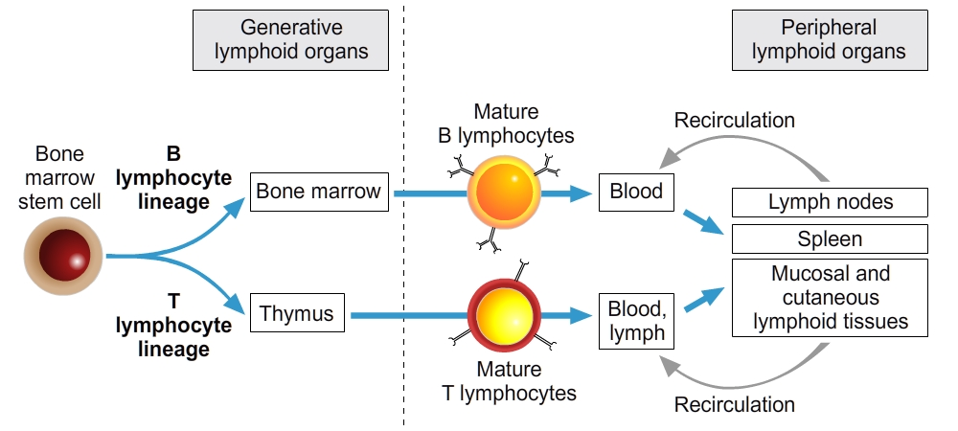
Maturation and circulation of lymphocytes
Lymphocytes develop from precursors in the generative lymphoid organs (the bone marrow and thymus).
Mature lymphocytes enter the peripheral lymphoid organs, where they respond to foreign antigens. From here they recirculate to the blood and lymph.

Slide 28
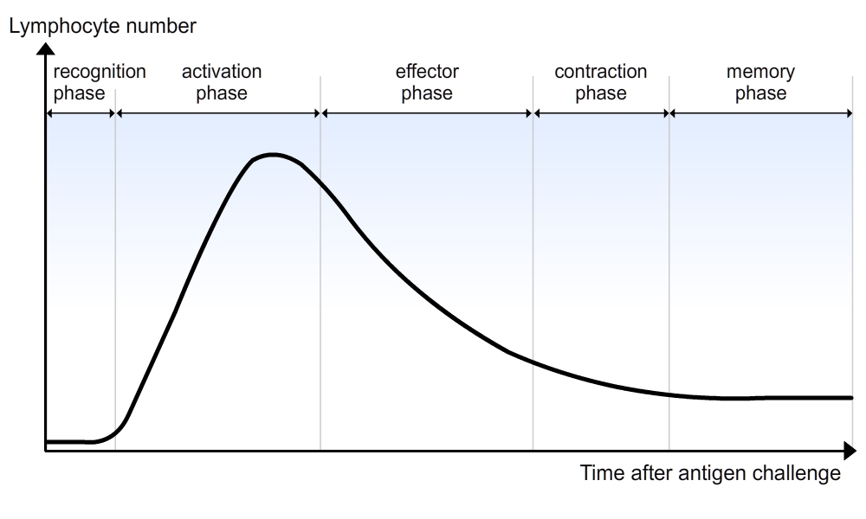
The adaptive response occurs in several steps
Mounting an adaptive immune response requires:
A recognition phase: recognition of the pathogen or other foreign material by lymphocytes
An activation phase, whereby antigen-specific lymphocytes receive a co-stimulatory signal to proliferate and differentiate into effector cells.
Clonal expansion of the antigen-specific lymphocytes.
An effector phase, during which effector lymphocytes are dispatched to the sites of antigen entry.
A contraction phase which occurs following clearance of the antigen.
A memory phase, during which surviving cells specific for the priming antigen may persist over long periods of time.

Slide 29
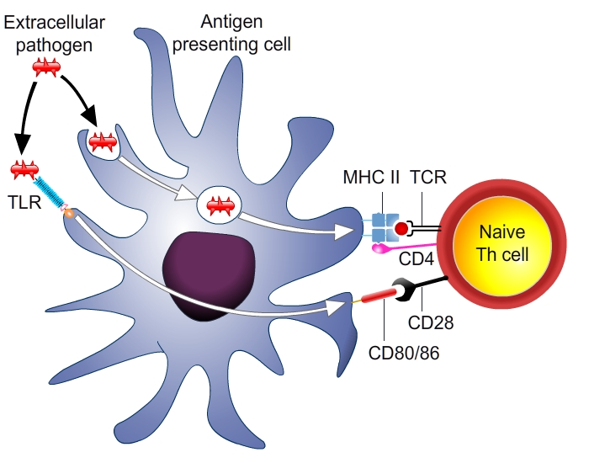
Step 1: Presentation of antigens by dendritic cells
Full activation of antigen-specific lymphocytes requires two signals:
"signal 1" : the antigen itself
"signal 2" : innate immune responses
This requirement for microbe-dependent second signals ensures that lymphocytes respond to infectious agents and not to harmless, noninfectious substances.
Dendritic cells integrate the two signals and present antigens to T cells.
Consequence:
For vaccines that contain antigens rather than whole microbes, substances called adjuvants have to be added to trigger innate immune reactions.
Two signals
1. Antigens (peptides) → TCR
2. PAMPs/DAMPs → Co-stimulation

Slide 30
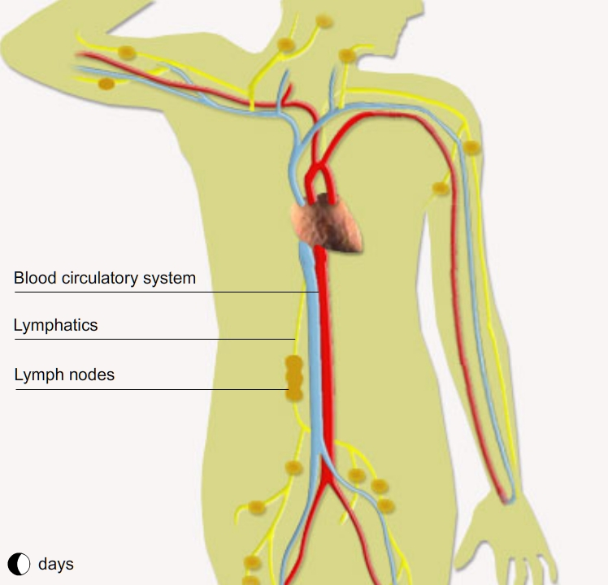
Antigen presentation: role of dendritic cells
Antigen sampling by dendritic cells (DCs) that migrate from infected tissues to lymph nodes and spleen
Antigen recognition and activation: interaction between DCs and T cells
Antigen clearance: Migration of activated T cells to site of infection

Slide 31
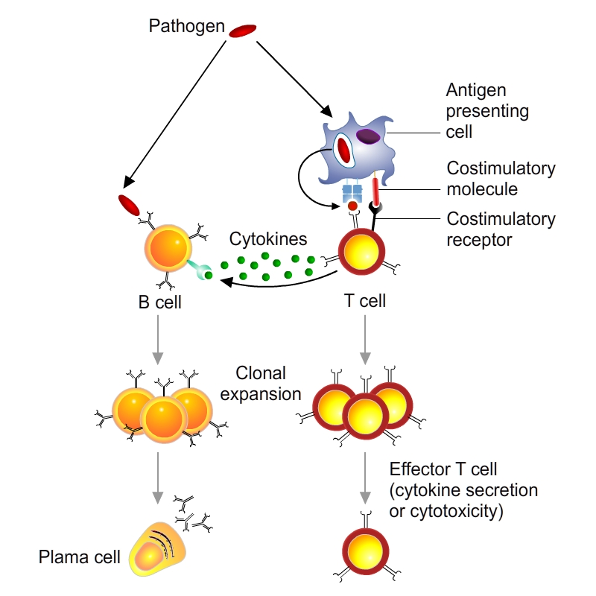
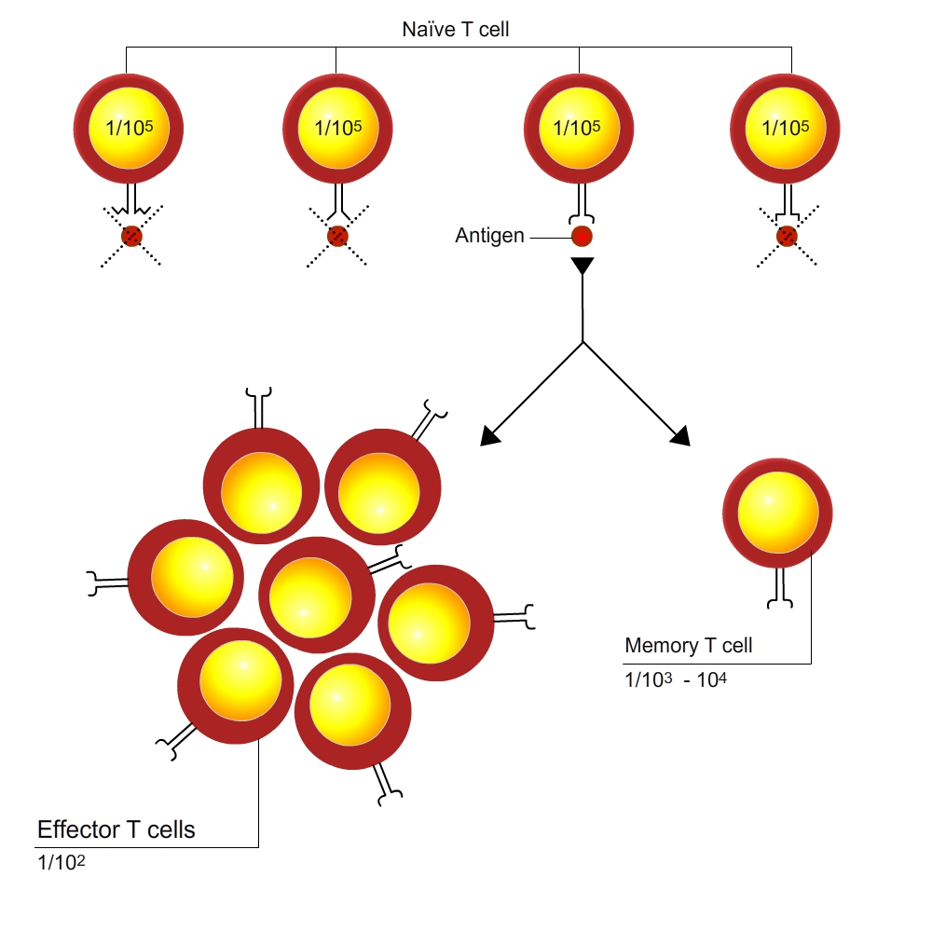
Step 2: Activation phase
Mounting an adaptive immune response requires an activation phase, during which antigen-specific lymphocytes receive a co-stimulatory signal to proliferate and differentiate into effector cells.
Activation
Proliferation: clonal expansion of the antigen-specific lymphocytes

Slide 32
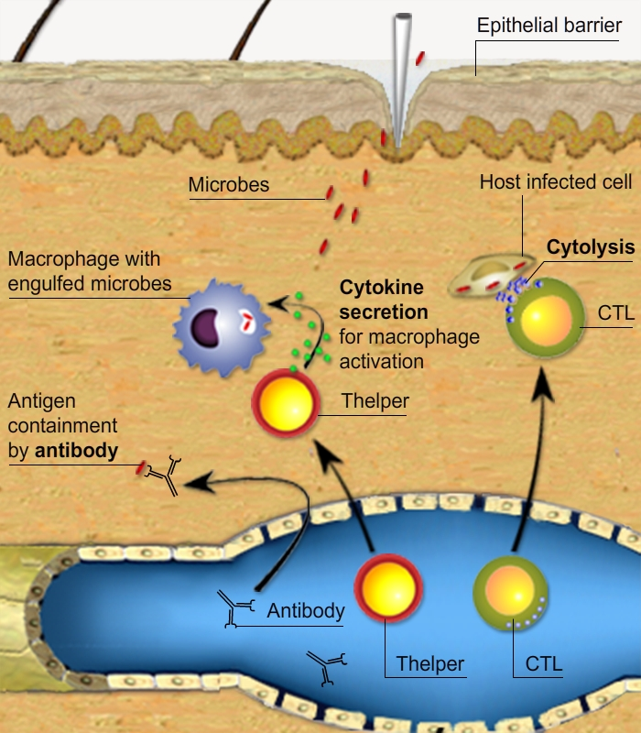
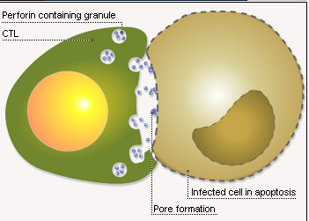
Step 3: Effector phase
Mounting an adaptive immune response requires an effector phase, during which effector lymphocytes are dispatched to the sites of antigen entry.

Slide 33
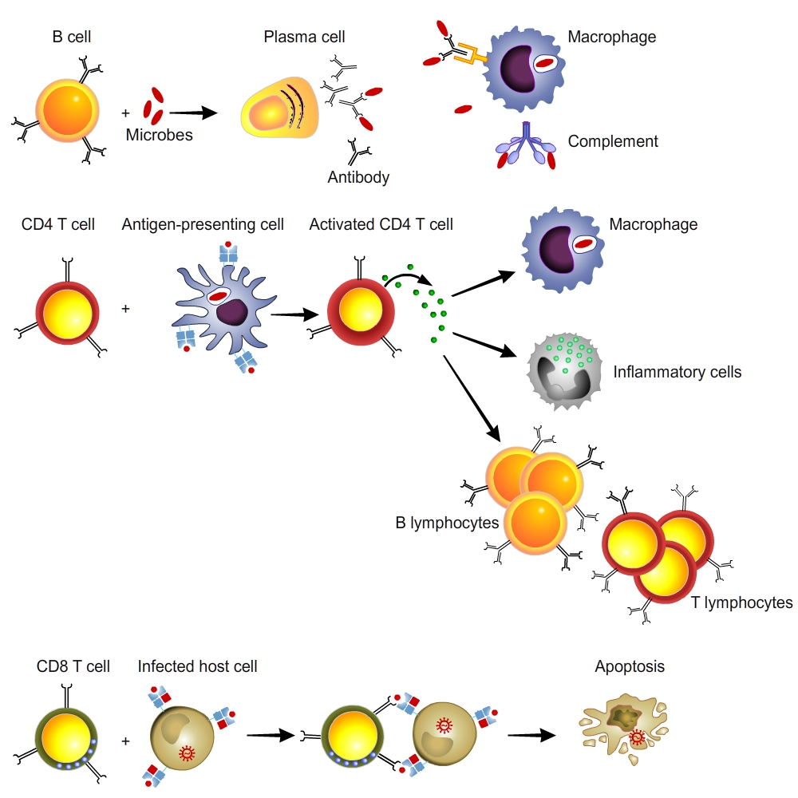
Conclusion 1B: Different Classes of lymphocytes
Different classes of lymphocytes recognize distinct types of antigens and differentiate into effector cells whose function is to eliminate the antigens.
B lymphocytes recognize soluble or cell surface antigens and differentiate into antibody-secreting cells.
Helper T lymphocytes recognize antigens on the surface of antigen-presenting cells and secrete cytokines, which stimulate different mechanisms of immunity and inflammation.
Cytotoxic (cytolytic) T lymphocytes recognize antigens on infected cells and kill these cells.

Slide 34
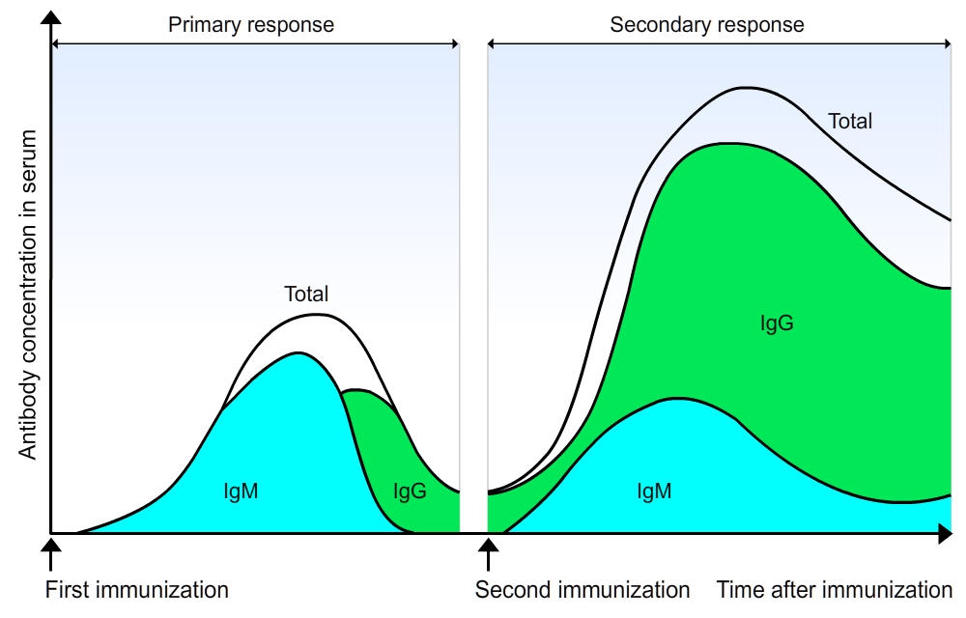

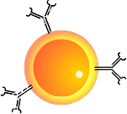

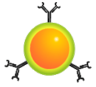
Primary versus secondary B cell response
Primary
antibody
response
First contact with an antigen activates naïve B cells.
  long lag period (5-10 days)
  low magnitude
  IgM > IgG (low affinity)
IgM
IgM
IgG
Secondary
antibody
response
Second contact with an antigen activates memory B cells.
  shorter lag period (1-3 days)
  higher magnitude
  IgG > IgM (high affinity)

Slide 35
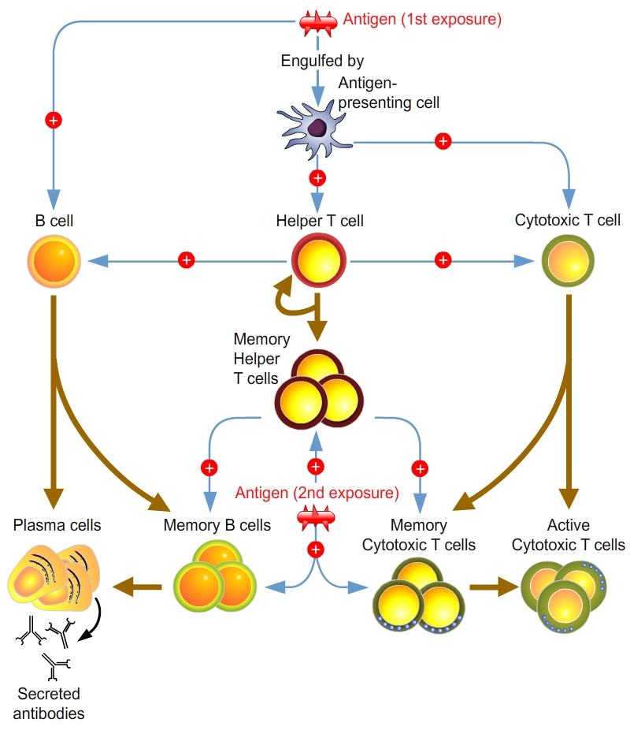
An overview of the acquired immune response

Slide 36
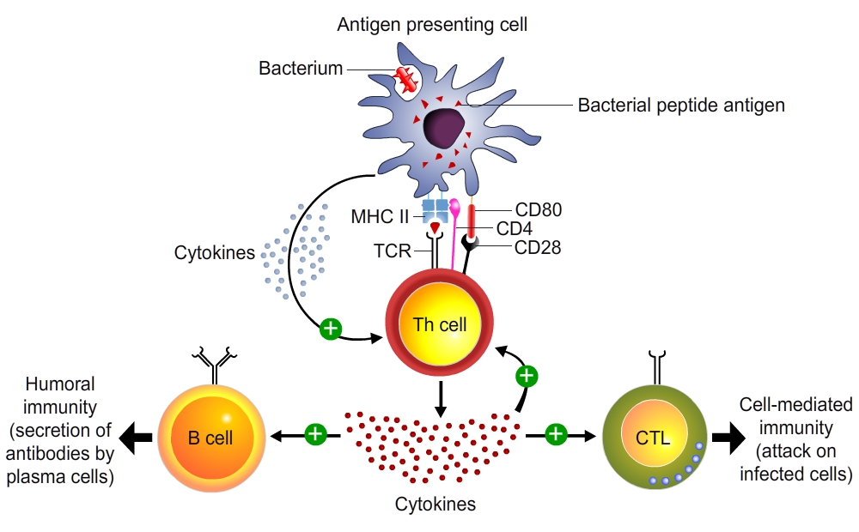
1. The central role of helper T cells in humoral and cell-mediated immune responses

Slide 37
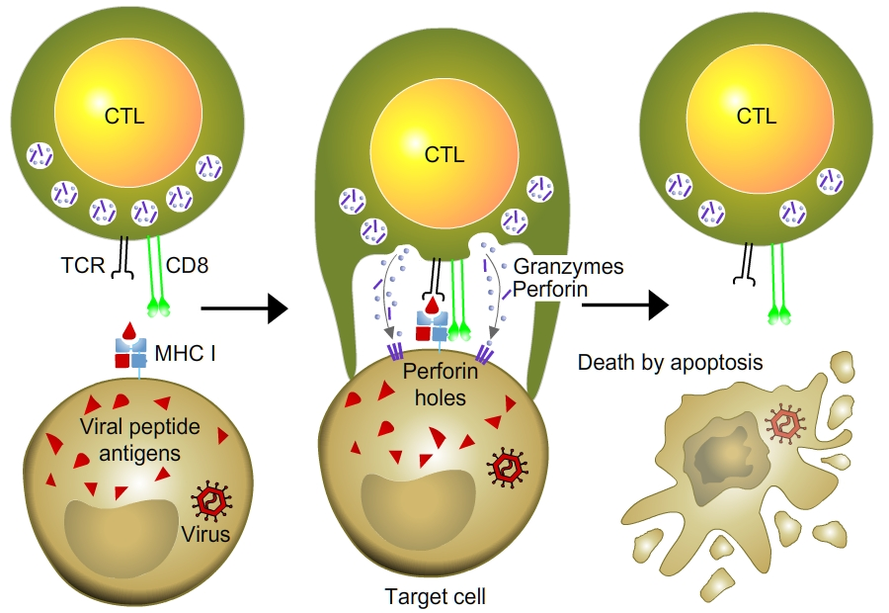
2. Cytotoxic T Cells: A Response to Infected Cells

Slide 38
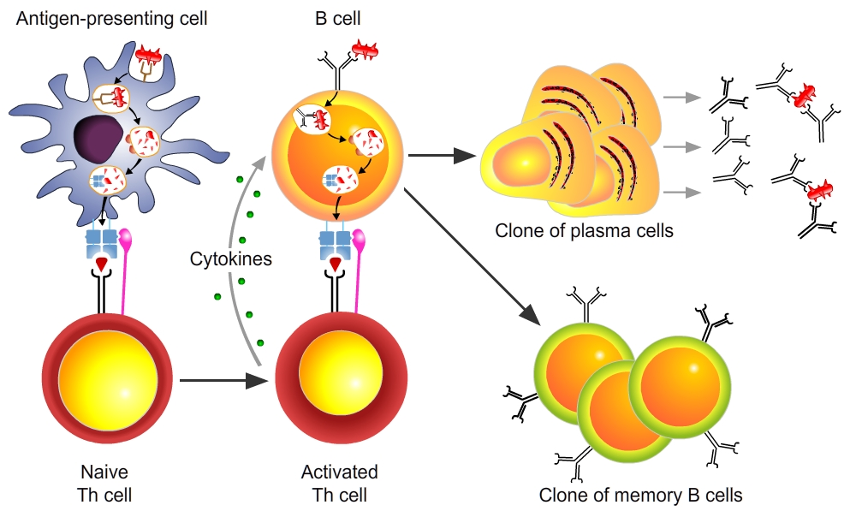
3. B cell activation in the humoral immune response

Slide 39
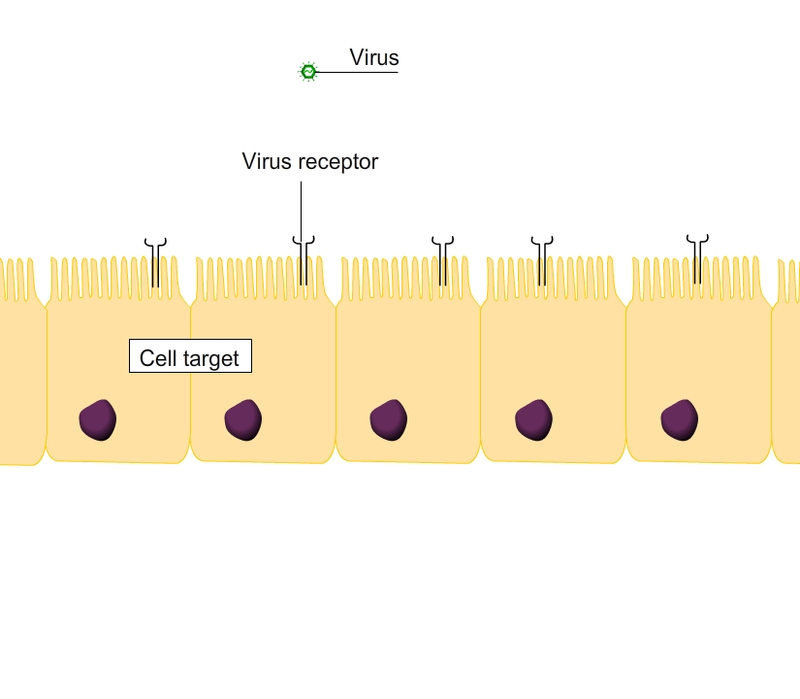
Defence against microbes
Viral infection |  | Bacterial infection |  | Parasitic infection
Cytopathogenic | Non- cytopathogenic | Extracellular | Intracellular | Protozoan | Helminths
Antibodies | CTL | Antibodies | Antibodies + CTL | Antibodies + CTL | IgE antibodies
Cytopathogenic Virus

Slide 40
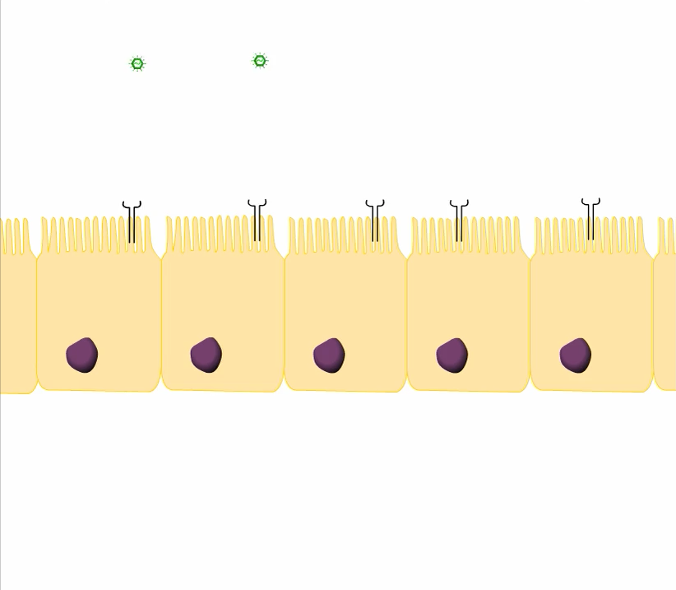
Defence against microbes
Viral infection |  | Bacterial infection |  | Parasitic infection
Cytopathogenic | Non- cytopathogenic | Extracellular | Intracellular | Protozoan | Helminths
Antibodies | CTL | Antibodies | Antibodies + CTL | Antibodies + CTL | IgE antibodies
Non-cytopathogenic Virus

Slide 41
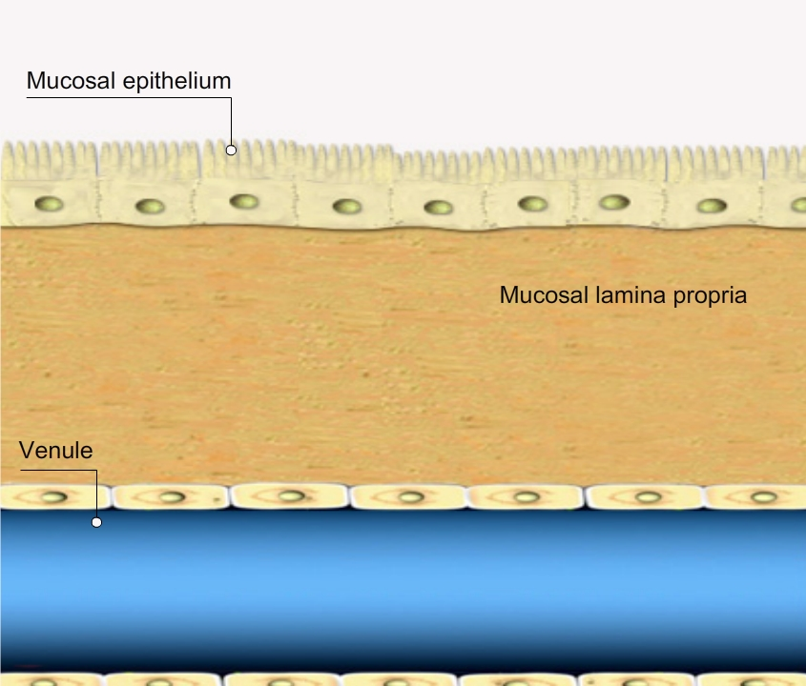
Defence against microbes
Viral infection |  | Bacterial infection |  | Parasitic infection
Cytopathogenic | Non- cytopathogenic | Extracellular | Intracellular | Protozoan | Helminths
Antibodies | CTL | Antibodies | Antibodies + CTL | Antibodies + CTL | IgE antibodies
Neutralization

Slide 42
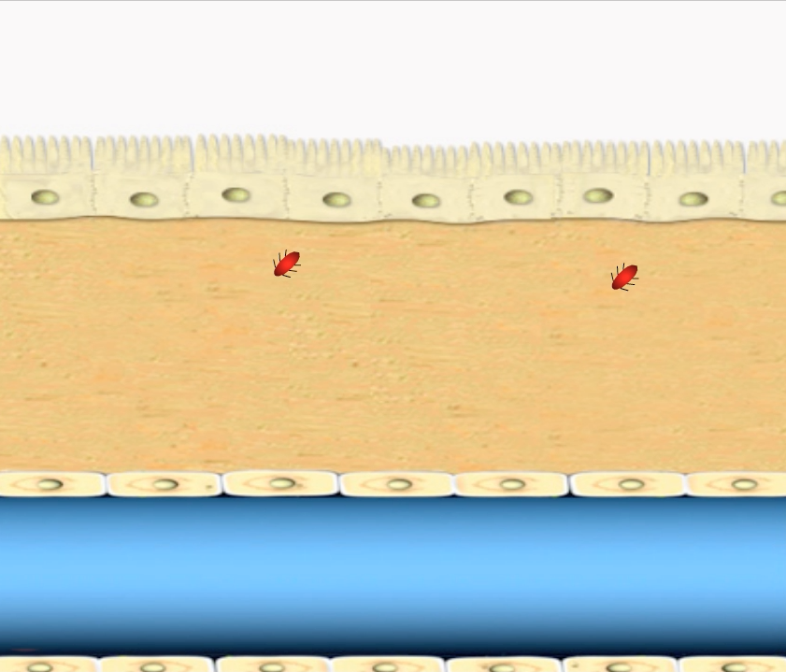
Defence against microbes
Viral infection |  | Bacterial infection |  | Parasitic infection
Cytopathogenic | Non- cytopathogenic | Extracellular | Intracellular | Protozoan | Helminths
Antibodies | CTL | Antibodies | Antibodies + CTL | Antibodies + CTL | IgE antibodies
Phagocytosis

Slide 43
Conclusion 1C
Adaptive immunity consists of humoral immunity, in which antibodies neutralize and eradicate extracellular microbes and toxins, and cell-mediated immunity, in which T lymphocytes eradicate intracellular microbes.
Adaptive immune responses consist of sequential phases: antigen recognition by lymphocytes, activation of the lymphocytes to proliferate and to differentiate into effector and memory cells, elimination of the microbes, decline of the immune response, and long-lived memory.
B lymphocytes are the only cells that produce antibodies. B lymphocytes express membrane antibodies that recognize antigens, and effector B cells secrete the antibodies that neutralize and eliminate the antigen.
T lymphocytes recognize peptide fragments of protein antigens displayed on other cells. Helper T lymphocytes activate phagocytes to destroy ingested microbes and activate B lymphocytes to produce antibodies. CTLs are cytotoxic: they kill infected cells harboring microbes in the cytoplasm.
APCs capture antigens of microbes that enter through epithelia, concentrate these antigens in lymphoid organs, and display the antigens for recognition by T cells.

Slide 44
Learning Objectives
Distinguish between innate and acquired immunity
Define pattern-recognition receptor and phagocytosis (innate immunity)
Describe the inflammation response (innate immunity)
Distinguish between the following pairs of terms: antigens and antibodies; B lymphocytes and T lymphocytes; antibodies and B cell receptors; primary and secondary immune responses; humoral and cell-mediated response;
Explain how B lymphocytes and T lymphocytes recognize specific antigens
Explain why the antigen receptors of lymphocytes are tested for self-reactivity
Describe clonal selection and distinguish between effector cells and memory cells
Explain how a single antigen can provoke a robust humoral response
Compare the processes of neutralization and opsonization

Slide 45
Summary
The physiological function of the immune system is to protect individuals against infections.
Innate immunity is an early line of defence, mediated by cells and molecules that are always present and ready to eliminate infectious microbes. Adaptive immunity is a type of immunity that is stimulated by microbes, has a fine specificity for foreign substances, and responds more effectively at each successive exposure to a microbe.
Lymphocytes are the cells of adaptive immunity and the only cells with clonally distributed receptors for antigens.
Adaptive immunity consists of humoral immunity, in which antibodies neutralize and eradicate extracellular microbes and toxins, and cell-mediated immunity, in which T lymphocytes eradicate intracellular microbes.
Adaptive immune responses consist of sequential phases: antigen recognition by lymphocytes, activation of the lymphocytes to proliferate and to differentiate into effector and memory cells, elimination of the microbes, decline of the immune response, and long-lived memory.
Different populations of lymphocytes serve distinct functions and may be distinguished by the expression of particular surface molecules.
B lymphocytes are the only cells that produce antibodies. B lymphocytes express surface antibodies that recognize antigens, and effector B cells secrete antibodies that neutralize and eliminate antigens.
T lymphocytes recognize peptide fragments of protein antigens displayed on other cells. Helper T lymphocytes activate phagocytes to destroy ingested microbes and activate B lymphocytes to produce antibodies. CTLs are cytotoxic: they kill infected cells harboring microbes in their cytoplasm.
APCs capture antigens of microbes that enter through epithelia, concentrate these antigens in lymphoid organs, and display the antigens for recognition by T cells.
Naive lymphocytes circulate through the peripheral lymphoid organs searching for foreign antigens. Effector T lymphocytes migrate to peripheral sites of infection, where they function to eliminate infectious microbes. Effector B lymphocytes remain in lymphoid organs and the bone marrow, from where they secrete antibodies that enter the circulation and find and eliminate microbes.

